Slide 1
LUI LO FA COSI! (FATEGLI LE BUCCE) VIDEO: endoscopia Treatment of a necrotic collection after tangential gastric resection by using an automated endoscopic debridement catheter
BENEDETTO NERI, md, Ph.d
FONDAZIONE POLICLINICO CAMPUS BIO MEDICO
U.O.C. ENDOSCOPIA DIGESTIVA OPERATIVA

Slide 2
BACKGROUND I
- Complications happen to those who operate
- For decades surgery has been the main actor when managing endoscopic failures…and still is
- Differently, first choice treatments for post-surgical complications traditionally included salvage surgery and interventional radiology
- The huge technical and technological evolution of the last years have led to the development of a new branch of endoscopy: the treatment of post-surgical complications

Slide 3
BACKGROUND II
- In a recent retrospective study on 1020 patients with bariatric surgery complications an algorythm for endoscopic management has been proposed and applied
- Clinical success achieved in 751 (81.6%) patients
- A 1% increased risk of redo-surgery every 10 days of delay to the first endoscopic treatment was reported

Slide 4
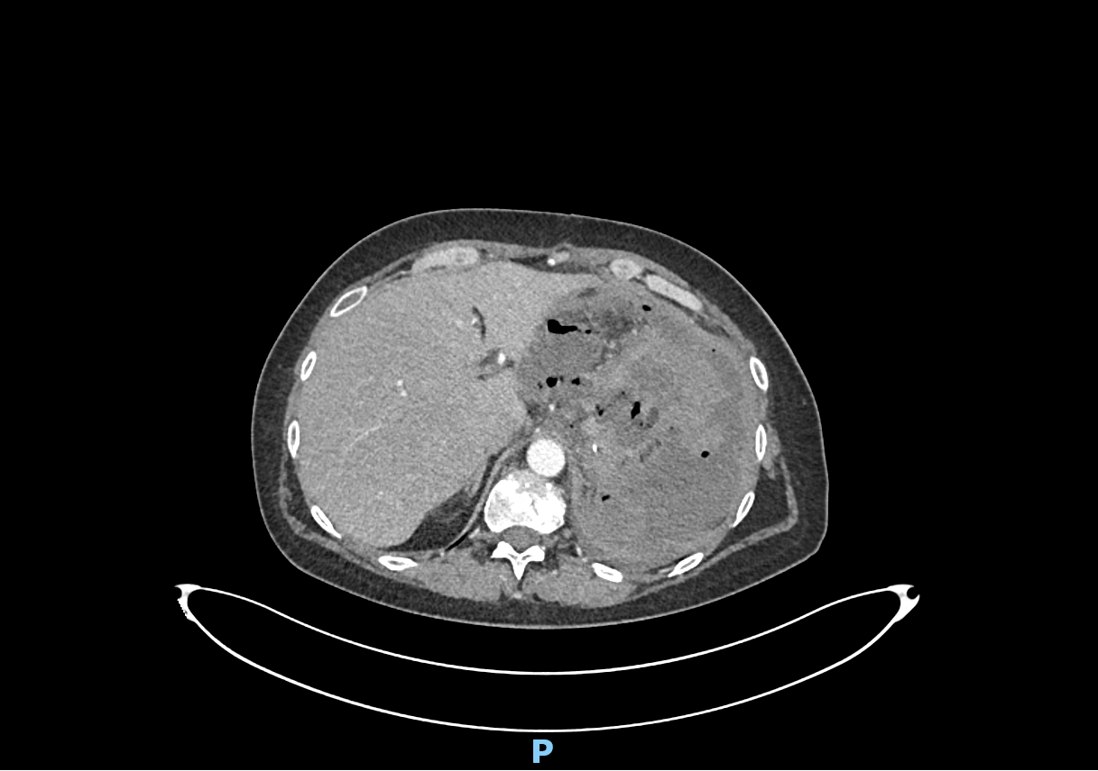
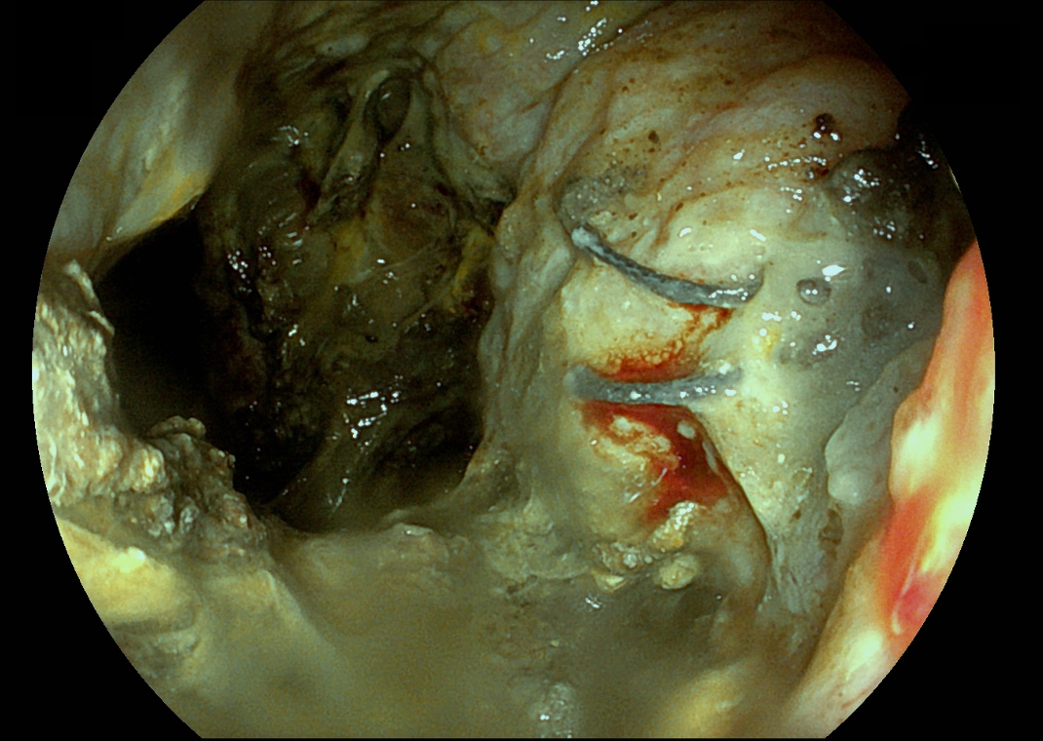
VIDEO CASE-REPORT
59-years-old woman undergoing proximal subtotal gastrectomy for a gastric stromal tumor
Fifteen days after surgery, the patient presented at the E.R. with sepsis, fever and abdominal pain
At c.e. CT scan At endoscopy

Slide 5
VIDEO CASE-REPORT

Slide 6
DISCUSSION
- The availability of new devices, new techniques and of a higher degree of expertise suggest a major role for endoscopy when managing surgical complications
- Endoscopy and surgery are complementary disciplines: the intervention at the right time of one or the other may ensure clinical success for the patient
- For the endoscopist: when managing non-ordinary situations, remember all the tools at you disposition…and think outside the box

